Slide 1
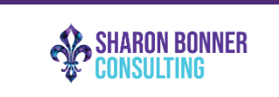
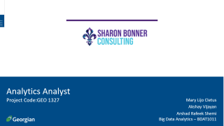
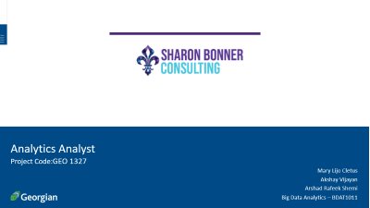
Analytics Analyst
Project Code:GEO 1327
Mary Lijo Cletus
Akshay Vijayan
Arshad Rafeek Shemi
Big Data Analytics – BDAT1011

Slide 2
Project Summary
The project will be focused on Digital Marketing Analysts and will be responsible for analyzing data from insights and reports from Sharon Bonner Consulting social media platforms. We will review and analyze the current and projected marketing initiatives and provide suggestions. Analyze keywords to determine relevant search terms to the organization and ensure the Search Engine Optimization. And finally, to analyze the overall business and provide recommendations on the current strategies. The project objectives are:
1. Conduct analysis that results in actionable insights and data-driven recommendations.
2. Identify, communicate, and act on opportunities and risks proactively.
3. Report and present performance and recommendations.

Slide 3
Team Profile
Akshay Vijayan
Arshad Rafeek Shemi
Mary Lijo Cletus
Developer
Business Analyst
Data Analyst
Data analysis and data visualization
Managing proper communication between client and the team,
Data analysis
Managing cleaning and developing solutions from data
Development and testing

Slide 4
Project Objectives
• Conduct analysis that results in actionable insights and data-driven recommendations.
• Identify, communicate, and act on opportunities and risks proactively.
• Report and present performance and recommendations.
Project Requirements
• A strategy to make everyone understand the different between event consulting and event producing.
• A strategy to get clients for Sharon Bonner Consulting from the historical data of Bright Ideas event agency.
• Immediate actionable insights that can be implemented for the initial push for the company.
• A 3–5-year analytical strategy for the company to move forward with event consulting.

Slide 5
Scope of Project
1) Analysis of data obtained from client or from other external sources that results in actionable insights and data-driven recommendations.
2) Report and present performance and recommendations.
3) Analytical strategy for 3–5-years prepared for the company to focus on event consulting industry.

Slide 6
Project Outcomes
• Getting proper data driven recommendations in marketing of the company
• Getting to know about new opportunities and risks of event consulting industry
• Get a detailed analysis report of previous clients and data
• Get project deliverables which can be used for future research purposes.
Project Deliverables
1. A final report with data-driven suggestions and reflections on how to improve our business
2. A 3–5-year future analytical plan
3. Immediate actionable insights that we can implement

Slide 7
Communication Plan
Name | Role | Send/Receive Email | Weekly Meetings | Decisions | Documentation
Sharon Bonner | Stakeholder | Yes | Attend | Project Scope | Project documentation
Brunilda Xhafellari | Instructor | Yes | Optional Attendee | Progression of Project | Grading
Brunilda Xhafellari | Project Manager | Yes | Suggested Attendee | Project and Task Management related items | Project Management Presentation components
Akshay Vijayan | Team Lead | Yes | Attend, Book | Team, Project and Own Tasks | Communication
Arshad Rafeek Shemi | Team Member | Yes | Attend, Agenda | Own Tasks | Documentation of different project phase
Mary Lijo Cletus | Team Member | Yes | Attend, Minutes | Own Tasks | Documentation of different project phase

Slide 8
High-Level Timeline Chart (GANTT)

Slide 9
Budget
Current Cost of Project
Task | Hours | Rate | Total
Akshay Vijayan | 8 | $ 50.00 | $ 400.00
Arshad Rafeek Shemi | 8 | $ 50.00 | $ 400.00
Mary Lijo Cletus | 8 | $ 50.00 | $ 400.00
Total |  |  | $ 1200.00
A total budget off $4800 per person ($400 x 12 weeks)

Slide 10
Project Progress Update
Summary of Current State
Completely Analysed the client website
Created a website Analysis Report
Provided Immediate Recommendations and updates to the client on website
Proper Communication with the client via weekly meeting
Current tasks
Website Analysis
Upcoming Plans
Social Media Analysis

Slide 11
Activities in Progress
Analysing Client’s Instagram and LinkedIn profile
Preparing for the client meeting that is to be held on 13/10/2022
Learning new tools for the project
Preparations for social data mining and analysis

Slide 12
Backlogs and Schedules
No backlogs
Third Client meeting:
13/10/2022

Slide 13
Activities and Works so far
First Client meeting was done on 21/09/2022
Second Client meeting was done on 29/09/2022
Scheduled group meetings via teams
Detailed discussion about the project requirements and deliverables of the client company
Detailed research on the client website
Immediate recommendations on website provided
Detailed discussion about client social media

Slide 14
Plan for Next week
Finding the performance parameters of the client social media
Preparation of detailed report on the analysis done on client social media

Slide 15
Individual Status Report – Akshay Vijayan
Provided initial recommendations for client website
Learned new tools and skills required for Data scrapping from Social Media

Slide 16
Individual Status Report – Mary Lijo Cletus
Created a website analysis report
Created a sample dashboard from the google analytics company website

Slide 17
Individual Status Report – Arshad Rafeek Shemi
Maintaining proper communication between client and team
Research on different parameters that are going to affect client social media

Slide 18
Conclusion
In this project we conduct analysis that results in actionable insights and data-driven recommendations. This is a great project for us to prove our analyzing expertise for future employers, as the impact of our work on this project can be easily measured and communicated. We here by thank the entire Georgian College faculty from Big Data Analytics program.

